Slide 1
The trains have left the Central Station
A snapshot of Elekta’s Agile transformation
Lars Gusch & Petrine Herbai

Slide 2
Elekta at a glance
Elekta is a human care company pioneering solutions for treating cancer and brain disorders
Around 3,800 employees worldwide
Headquarters in Stockholm, Sweden
Close to 45 offices in 30 countries
Every day 100,000 patient receive diagnosis, treatment or follow-up by an Elekta solution

Slide 3
Agenda
Introduction & Transformation Roadmap
Highlights of the Portfolio Level
Program Level
Highlights of the Team Level
Conclusions
Notes:
We will give you some brief highlights of the portfolio and team level but spend most of the time on the program level, and give you some practical examples of how we handle it. But first some overview.

Slide 4
A world health problem
Cancer is a leading cause of death worldwide, with approximately 14 million new cases and 8.2 million cancer related deaths in 2012.
The most common sites of cancer diagnosed in 2012 worldwide were lung, breast, prostate, colorectum, stomach, and cervix cancer.
Tobacco use, alcohol use, unhealthy diet and physical inactivity are the main cancer risk factors worldwide.
Ageing is another fundamental factor for the development of cancer.
It is expected that annual cancer cases will rise from 14 million in 2012 to 22 within the next 2 decades.
Many cancers have a high chance of cure if detected early and treated adequately.
http://www.who.int/mediacentre/factsheets/fs297/en/
Notes:
What are we doing at Elekta? We are working with a world health problem…
Even if we take out the aging factor, the number of new cases increase.

Slide 5
Vision:
Information-guided cancer care™
Better information will transform cancer care.
https://www.youtube.com/watch?v=P7h0VfH5Wf8
Notes:
We fight cancer and our vision is information-guided cancer care, that better information will transform cancer care. Let’s take a closer look at the vision, as it also explains what we do at Elekta.

Slide 6
Our product portfolio
Brachytherapy
Neuroscience
Oncology
Software
MOSAIQ®
Monaco®
XiO®
METRIQ®
ANALYTIQ®
Oncentra® External Beam
Clarity ®
Notes:
Elekta has a broad product portfolio including various equipment for treating cancer and software for the complete clinical workflow (diagnosis, treatment planning and treatment delivery, and follow-up). We work with software and it is our agile journey that we are going to describe.

Slide 7
Elekta R&D locations Software development in ART
Stockholm & Uppsala
Beijing
Helsinki
Veenendaal
Crawley
Montreal
Linköping
Milan
Sunnyvale
Shanghai
St. Louis
Schwabmünchen
Notes:
So on the software side, we had development over many time zones, and with people with different background and history, working on separate products.

Slide 8
The Challenge
Enhance patient and customer value by providing solutions that improve, prolong and save lives BETTER & FASTER .
Make Product Creation teams across Elekta SW work together to deliver product solutions, share integrated and harmonized processes, practices, and tools, and align themselves with global priorities and with each other.
Notes:
Our challenge is to provide solutions that improve patient care (instead of a pallet of products), and do it better and faster.
Make Product Creation teams work together, share processes, practices and tools, and to align with global priorities.

Slide 9
Scaling Agile
Notes:
That is where we started our agile transformation at Elekta…

Slide 10
Historical overview of our Agile Transformation
Scrum for 3-5 distributed teams
Scaling up Scrum from 3 to 9 teams
Introduce SAFe for Scrum teams
Introduce SAFe to all teams
2007 ….. 2012 2013 2014
Increased our throughput
Deliverables at every sprint
Escalated any issues much sooner
Allowed agility during development (features)
Team could focus on one project
Overall happy teams
Insufficient work on design and architecture
Silos between scrum teams
Dependency and integration issues
Unclear overall objectives & plan
Lack of visibility of the big picture
Scrum of scrum not being effective
Notes:
In brief, we started with Scrum in 2007, when Nucletron was not yet acquired by Elekta.
Elekta bought Nucletron in 2011, and we introduced Scrum to teams in St Louis and Shanghai, working on the same product.
Saw some good and bad with scaling up:
We could see that Scrum did not address all areas of an enterprise. We were missing
An intake process handling product and portfolio at a higher level
System level design and architecture runway.
An organization for coordinate and align teams, handle common development environment and tools, and for integration.
Etc.
So we decided to introduce SAFe. First for teams already familiar with Scrum, and later on for all software development.
Why did you chose SAFe?
It addressed the limitations we saw with Scrum
It was the only method we knew about and we were urgent to get something in place quickly

Slide 11
Scale Agile Framework for SW in Elekta
Where do we
want to go?
How do we get there?
2013 Starting Up
2014 Get it running
2015 Accelerate
Holistic view from the start and buy in from upper management
Brought in consultants
Started an agile release train for teams with Scrum experience
SAFe training for ALL in the new train
Lean & Agile training for teams without Scrum experience
Obtain a functioning program level
Introduced SAFe for all teams (4 trains)
Started a number of community of practices with focus on practices and quality
Obtain a functioning portfolio level
Defined intake processes
Road-mapping through agile estimates and planning
Regular Town Hall Meetings to celebrate success and progress
Notes:
We started SAFe late 2013, worked to get a functioning program level in 2014, and will put more effort on the portfolio level 2015.
When we started we already had buy in from management on lean & agile. So we could take a holistic view and include business, budgeting, and time reporting, product management and product development.
We brought in expertise to help us.
We also had the advantage of having many teams already familiar with Scrum and could start with one train with those teams.
All people in the new train got SAFe training.
When we rolled out SAFe for all teams, all teams without Scrum experience first got lean & agile training. We had learned that the mechanics of Scrum is not enough, you have to understand the principles behind as well.
To enhance cross team sharing of experience, we started a number of community of practices on engineering and quality.
This year we will continue to work on the portfolio level with intake process and agile estimate and planning on roadmap level. And we have also put communication on the same cadence as the development, and have scheduled regular town-halls on various levels.

Slide 12
What we have changed through the introduction of SAFe
Introduced Rally for Agile project management
Adopted organization and roles for SAFe (RTE, PM/PO, UX, EA, agile coaches)
Streamlined development tooling and processes
Updated the Quality System for Agile development
Simplified project time reporting
Notes:
Before we do a dive into the different levels, let’s summarize what we have changed and what we not yet have changed yet with the introduction of Scrum and SAFe.

Slide 13
What we have NOT changed yet through the introduction of SAFe
Requirements Management and Traceability (in progress)
Performance Review and Planning (in evaluation)
Stage Gate process for Project Management
Explorations phases and problem report handling (escalations) are handled outside SAFe
Notes:
We are introducing new tools for requirements and test cases that will allow for automatic traceability.
We do performance review and planning for individuals. How do you do it when you work in teams, is under evaluation.
We still have an Elekta global gate process for project management and this process will have to change when/if we go towards continuous delivery (we are not there yet, we still have planned projects with a start and end date and the high level scope defined).
Do you still have project managers?
Yes, on program level managing the release and stage gate. We call it program managers.
Some project managers are now agile coaches, some became RTEs, and some are program managers.

Slide 14
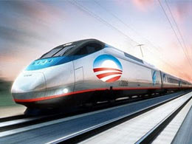
Elekta BASS has 4 Release Trains (Jan 2015)
Knowledge Management
4 teams in Sunnyvale (and remote)
Care Management
4 teams in Sunnyvale (and remote)
Treatment Management
7 teams in Shanghai, St Louis & Uppsala
New SW platform
12 teams in St Louis, Sunnyvale & Uppsala
Escalation teams are not in Agile Release Trains
Notes:
Today we have 4 trains including teams on 3 continents. Our largest trains include teams working on a new software platform. The smaller trains work on legacy products and smaller product areas. More and more teams are moving over to the new software platform train and soon this train will be divided according to value streams/products.

Slide 15
Notes:
That was the introduction setting the stage. We will now go through level by level. We will only very short mention what we think is our main achievement on portfolio and team level, and spend most of this presentation on the practical examples of how we have implemented the program level.

Slide 16
Portfolio Level
Notes:
We have made substantial progress when it comes to agile portfolio estimation and planning.

Slide 17
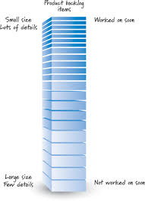
Agile Portfolio Estimation & Planning
Business and Engineering: Cross-functional, collaborative sizing effort
Alignment of capacity against strategic areas
Roadmap translated into prioritized backlog per strategic area
Demand/Capacity Analysis
Growth Scenario Analysis
Backlog Refinement
Planned: Quarterly assessment, adjustment and continuous improvement of the process
Notes:
At portfolio level we want to better understand our capacity allocation against the various product lines/strategic areas and make realistic roadmaps, where we actually can deliver according to the expectations/demand.
So we have established a cross-functional epic estimation process to size the demand:
Translate the roadmap into a prioritized backlog
Put together a cross functional team and size the epics
Compare our demand versus capacity to improve planning and tentatively predict roadmap delivery.
Do a second round with features (through backlog refinement)
Establish a continuous improvement loop where we assess our estimation process quarterly and adjust.

Slide 18
Accuracy in Estimation
Epic Level Estimation
High Level T-Shirt Sizing
High level projection: # of sprints for ideally staffed team to accomplish 1 epic
Cross-functional team: Business SMEs, architects, system owners & engineers
NOT a commitment & will get refined
Feature Level Estimation
Well-groomed features
High level projection: # of sprints to accomplish the feature
Provided by program level: Product owner, system architects & scrum team
Tentatively slot features into PIs for release planning
Notes:
We use the same scale for epics and features. We call it Feature Points. Which is decoupled from Story Points.
(XS, S, M, L, XL (2, 5, 10, 25, 100))
As a first estimate, we use #ideal sprints for a team to complete as the size, but we will soon get data on velocity.
Epic is NOT a commitment, it will get refined.
We use the same scale for features. Feature estimates include the scrum team (and PO and others).
Feature estimates are used to tentatively plan features into PIs for release planning.
Soon the history will give the train a velocity in feature points.

Slide 19
Accuracy in Estimation
Story Level Estimation
Scrum teams break down features into user stories
Estimate at a more granular level in a unit of story points
Use historical velocity data to commit to work pulled into a sprint
The closer we get to executing on the work, the more we break it down, and
the more accurate our estimates become.
We are in the process of establishing a quarterly feedback loop to assess how accurate our higher level estimates are and refine the process and the plan.
Notes:
Story level is another scale, Story Points, and are decoupled from Feature Points.
Team velocities are measured in Story Points. They are individual per team and are used for PI and sprint planning.

Slide 20
Program Level

Slide 21
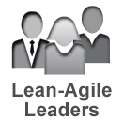
Program level @Elekta
Notes:
Here is an overview of the implemented functions & artifacts according to the recommendations from SAFe including key attributes. The items with a green check mark mean that we at Elekta are comfortable with the current implementation, a vacuum cleaner symbolizes that we are currently working on refining the implementation of the item.
Agile leaders - most important, in our view, are managers, leaders and executive management. They have to adopt the lean philosophy and are therefore primary targeting group for initial SAFe training. Agile leaders should adopt the following characteristics:
Lead the change
Emphasize life long learning
Develop people
Inspire and align to the vision
Decentralize decision making
Unlock intrinsic motivation
ART – Relatively easy to define according to value streams, they need constant evaluation and adaptation though.
Business owners are part of lean & agile leaders. They are responsible for value delivery (ROI), business objectives and business value, and shall provide constant feedback to the team.
Program backlog is managed through Product Management (PM). It contains future features (both business & architecture) that gives benefits to business. Prioritization is necessary at each PI boundary, and constant backlog grooming is required. Important to make small features that fit in a single PI!
Vision describes the solution to be delivered (features + NFR) and is a contribution from a number of people (architects, PM, teams, customers, etc.)
Roadmap describes deliverables over the near term time line (3-6 month with high confidence, and after that lower confidence). It is developed by PM, and is a challenge for us because of:
Legacy products
All new product in vision
Previous commitments
Program epics are constrained to one release train and require portfolio involvement. They are larger than features, but still sizable, and are a challenge for us because of:
All existing epics are not sized
Not enough constant backlog grooming being done yet
Architectural runway is the infrastructure code to support high priority features. They are sometimes difficult to implement incrementally. They are part of the program backlog and need good descriptions as there might be no obvious benefit for PM at first glance. Building an architectural runway is a challenge for us because of:
Has to support entire new platform (balance fallback to waterfall vs. too agile (undefined))
Shall also support legacy products

Slide 22
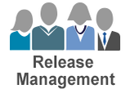
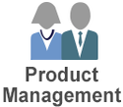
Program level @Elekta
Notes:
RTE - keeps the train on the tracks, is the chief scrum master, and act as an “agile project manager”
What are the key skills of an RTE?
Facilitator – No fear, communicative, alert
Agile mindset – Understand the lean & agile principles behind
Daily tasks? Mainly communicate with program level functions. Servant leadership
UX – dedicated group which was created during the implementation of SAFe according to the recommendations. It has proofed to be highly valuable during development by streamlining all user centered activities for all development teams.
DevOps - responsible for deployment as customer product, keeps the stuff together, part of operations, shorten lead time, close cooperation with teams & system team & PM. Don’t underestimate the size and need of this team!
System team - Integration & evaluation of full system functionality, builds infrastructure, system testing & demo, release, close cooperation with teams and DevOps. Don’t underestimate the size and need of this team!
What is the difference between System Team & DevOps?
DevOps work closer to the customer & release management. System team works closer to development teams. DevOps and System team have to work together hand in hand.
Product management - Backlog owner, building, maintaining and presenting vision & roadmap, works closely with PO to optimize feature delivery. PM has backlog grooming responsibility and plays a key role in preparation and execution of the PI. Their activities should be customer facing and business oriented.
System architect – responsible for system functionality vs. Stakeholder & customer vision. They should maintain and evolve the implementation framework, NFR governance. System architects own the architectural runway and communicate it throughout the ART.
Release management - plans, manages, governs releases for the train.
What is difficult?
Release management – (unclear roles and responsibilities) Regulatory requirements on patient safety and V&V
Release on demand – Backlog of old commitments, ”old promises”
Finding the right scope for a release

Slide 23
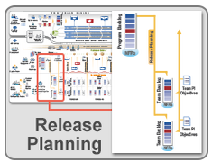
Program level @Elekta
Challenges:
Prioritized backlog, time zones, travel, language, communication
Preferred solution:
Gather everybody involved in the agile release train for a joint PI planning meeting in one location.
Notes:
Release planning is a key event for the ART
Result shall be: PI objectives as a time boxed commitment, the PI planning includes I&A from past PI
Ideal Path: Everybody gathers face to face around vision & prioritized backlog. Team breakouts and inter team communication lead to a plan for the 3 month period.
Challenges with multi-site development! Following slides depict how we did it with all people face-to-face.

Slide 24
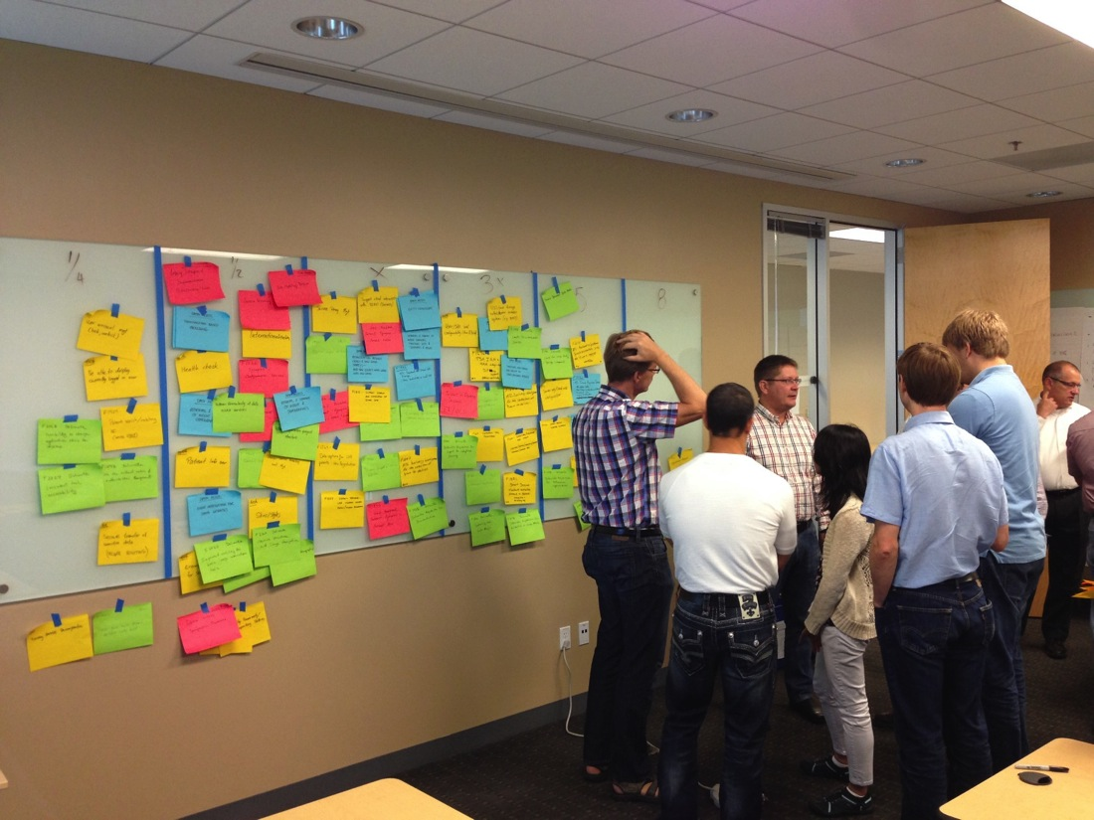
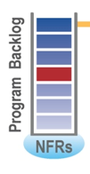
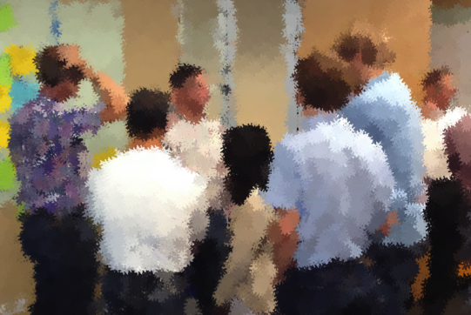
Program level @Elekta
Architecture pre- planning
Notes:
This picture shows a gathering of key developers, architects and PM’s during a pre- planning event. We experience that constant backlog grooming is very beneficial and should not be underestimated. Even pre-planning meetings have proven to be very valuable for the preparation of the PI planning with regards to program backlog and the architectural runway.

Slide 25
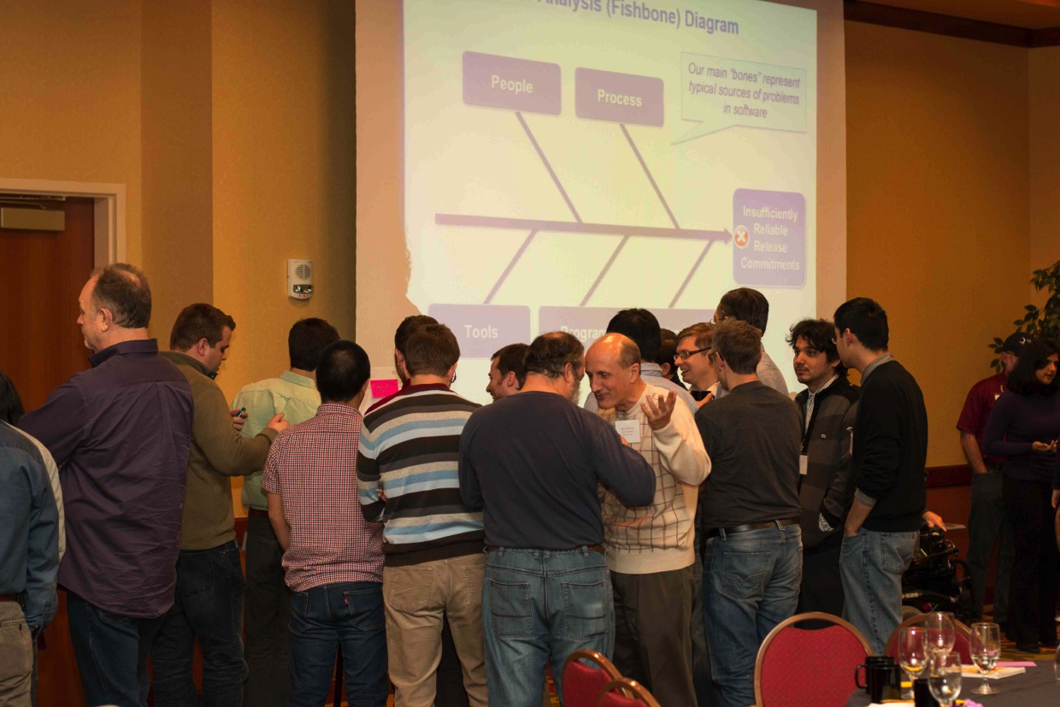
Program level @Elekta
I&A Brainstorming
Notes:
The Inspect & Adapt is an important part of the planning meeting and supports Kaizen (continuous improvement) as integral part of lean and agile philosophy
I&A includes
Solution demo
Qualitative & quantitative measurements
PI objective evaluation
Problem solving workshop

Slide 26
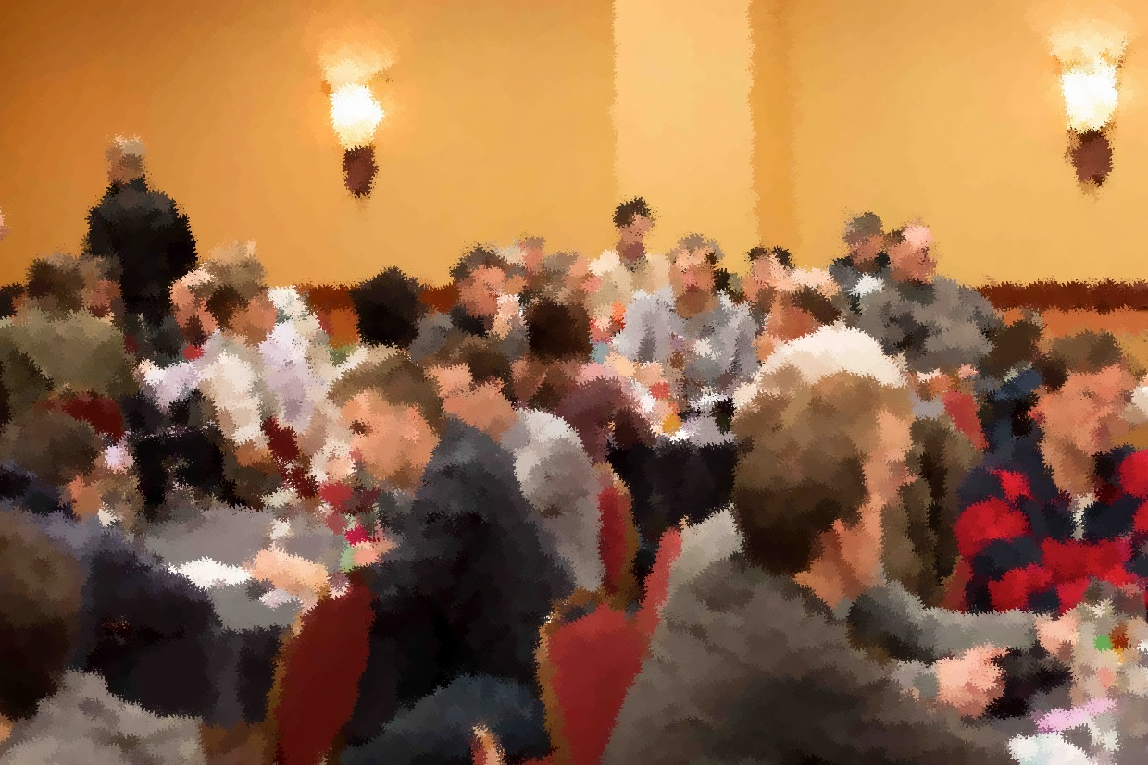
Program level @Elekta
Cooperation 3.0
Notes:
A joint PI planning with global participation creates and amazing atmosphere. One of the greatest benefits of having everybody gathered in one place is the active cooperation between all stakeholders, including teams, product managers, architects etc.

Slide 27
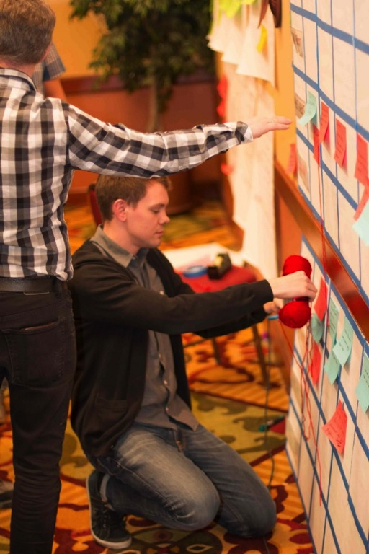
Program level @Elekta
Dependencies
Notes:
A program board is used to visualize the PI plan for all teams with key features and milestones.
Additionally all inter team dependencies are marked out with read thread. There is a handshake between the teams about give’s and get’s. It is very valuable to have the dependencies visible for everybody.

Slide 28
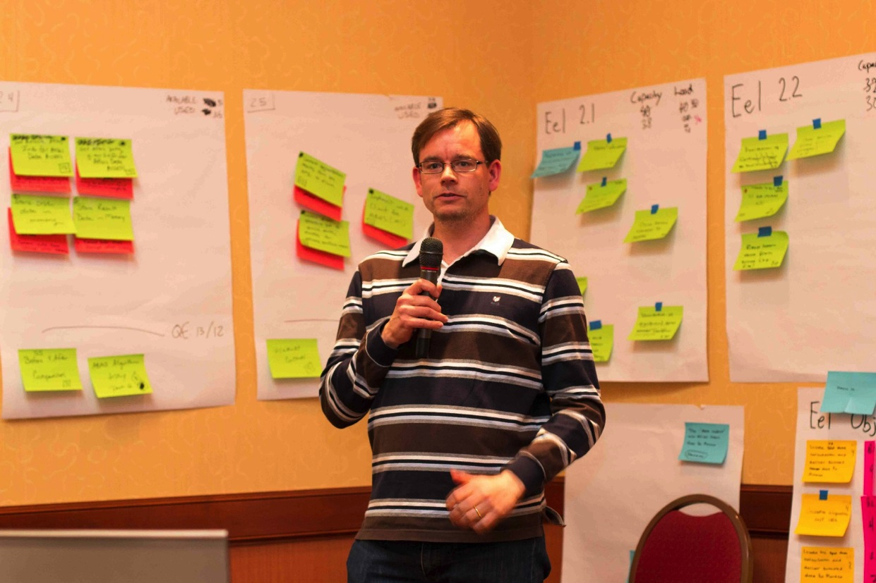
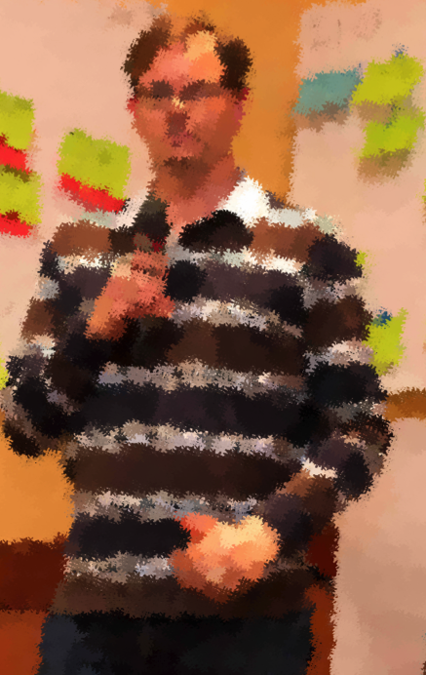
Program level @Elekta
The Plan
Notes:
Capacity
Load
User Stories
Milestones

Slide 29
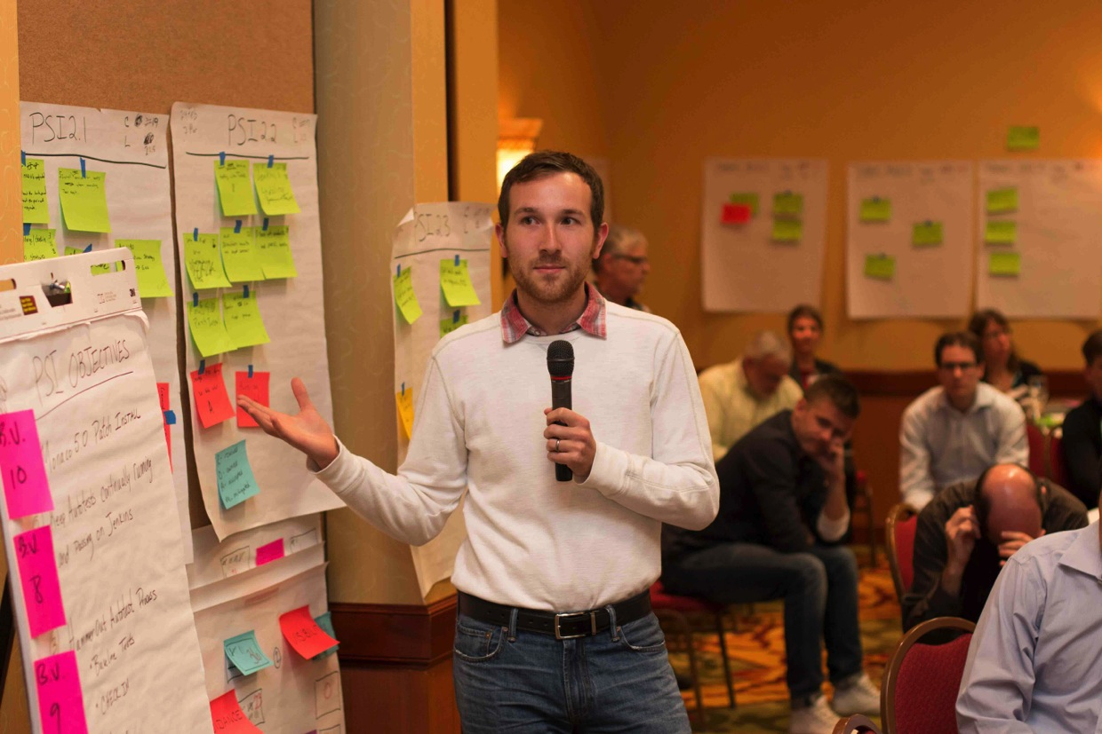
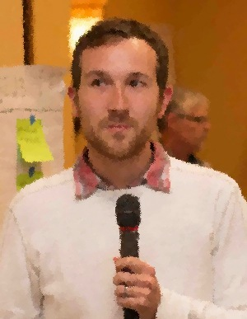
Program level @Elekta
The Objectives
Notes:
PI Objectives will be formulated and are important for Business Value (BV) given by the business owners. The BV are evaluated after PI for completion and presented during the I&A event. Objectives are committed goals for teams!
PM & Team have to be aware about importance of objectives and business values.

Slide 30
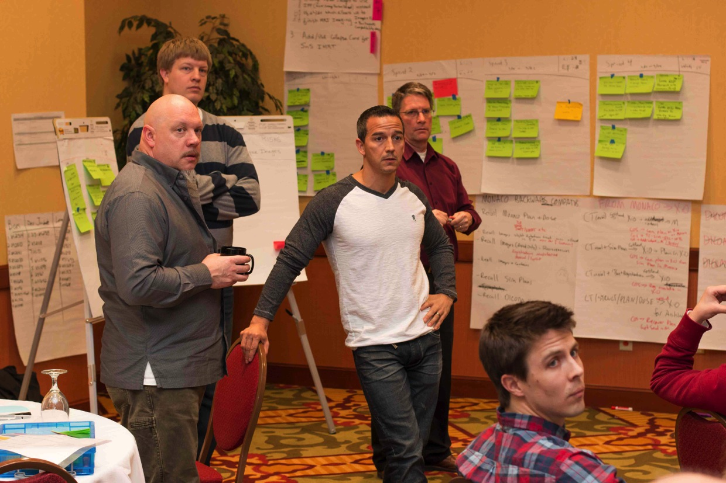
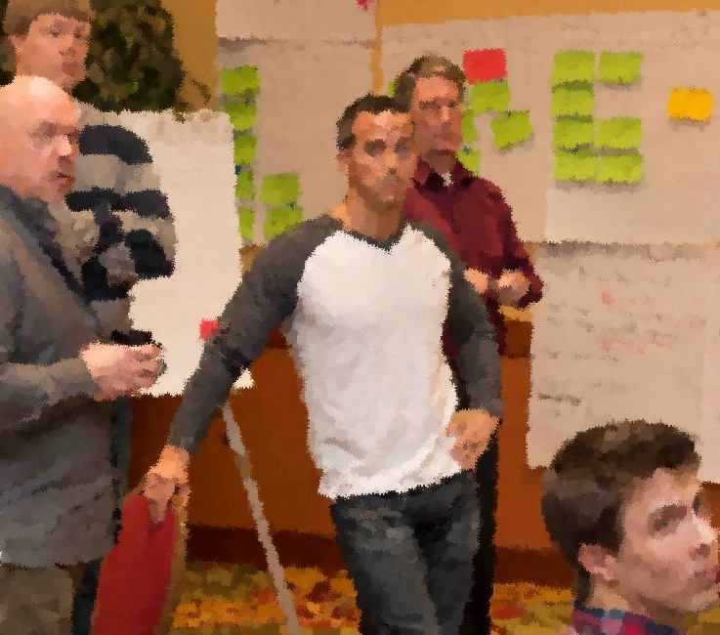
Program level @Elekta
Business owners / PM
Notes:
Business owners (BO) do follow the planning closely.
Draft plan review and final plan review are build in synchronization points where the planning results are presented transparently to all participants. After evaluation and cross check with the priorities on the backlog, the BO can demand re-planning. Again the interaction through out the planning is desired and is an integral part of the PI planning meeting.

Slide 31
Program level @Elekta
PI planning conclusion:
Joint PI planning with all involved individuals in one place is the preferred and most collaborative solution to get to jointly develop PI objectives.
However:
Downscaled co-located planning meetings might be an alternative if e.g. budget do not allow for meeting face-to-face. Well functioning conferencing equipment (video conferencing, remote presentation etc.) along with electronic tools to reflect different artifacts of the planning (e.g. planning board, risk board, scrum of scrums etc.) are mandatory prerequisites for such meting. The time difference is managed through recorded presentations, and spreading the planning out on more days.

Slide 32
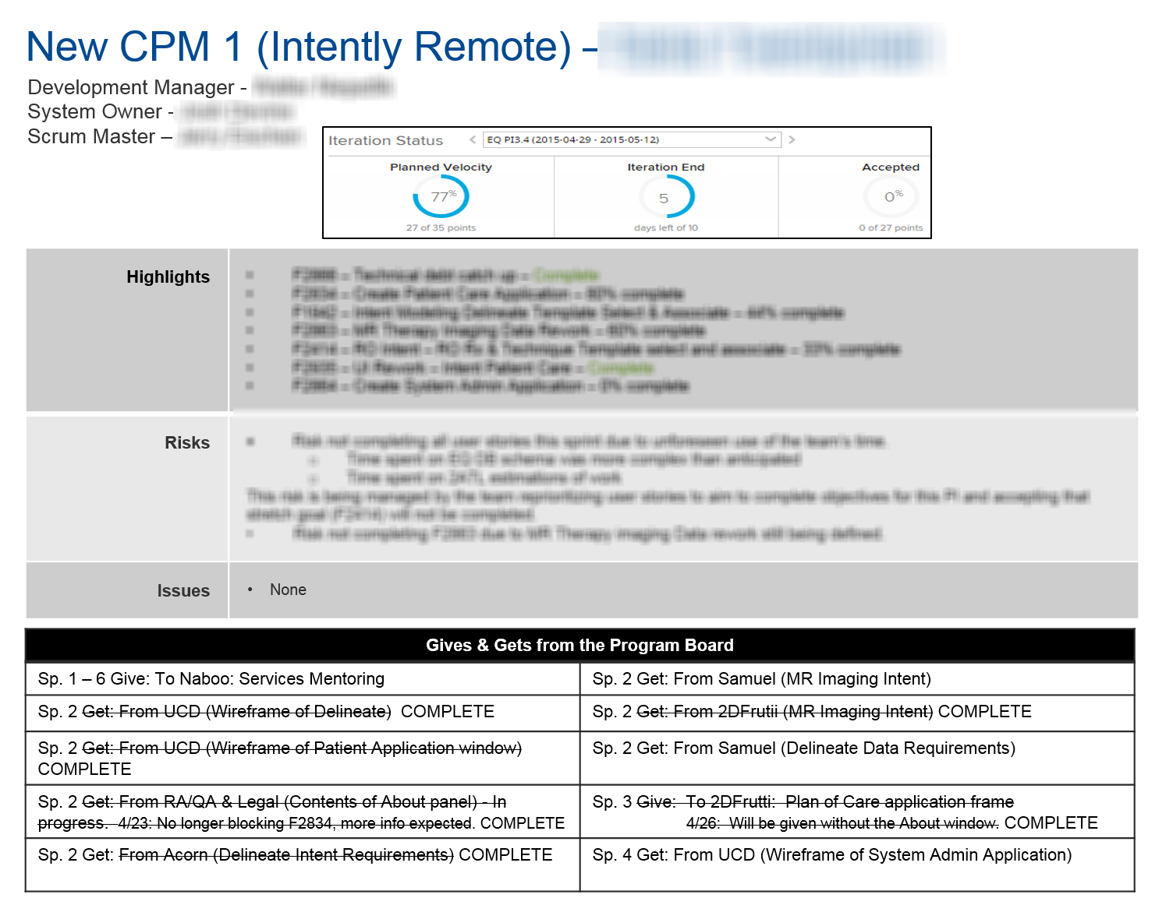
Program level @Elekta
Notes:
The weekly program management meetings are important to follow the progress of the ART during the PI period. They are used for important program level communication, synchronization, identification of risks etc.
During the meetings the team metrics are presented, they include the following key elements:
Feature completeness by story points
Average velocity
Dependencies
Defects

Slide 33
Team Level
Notes:
As we assume everyone to be familiar with Scrum we just wanted to point out a few learnings on team level.

Slide 34
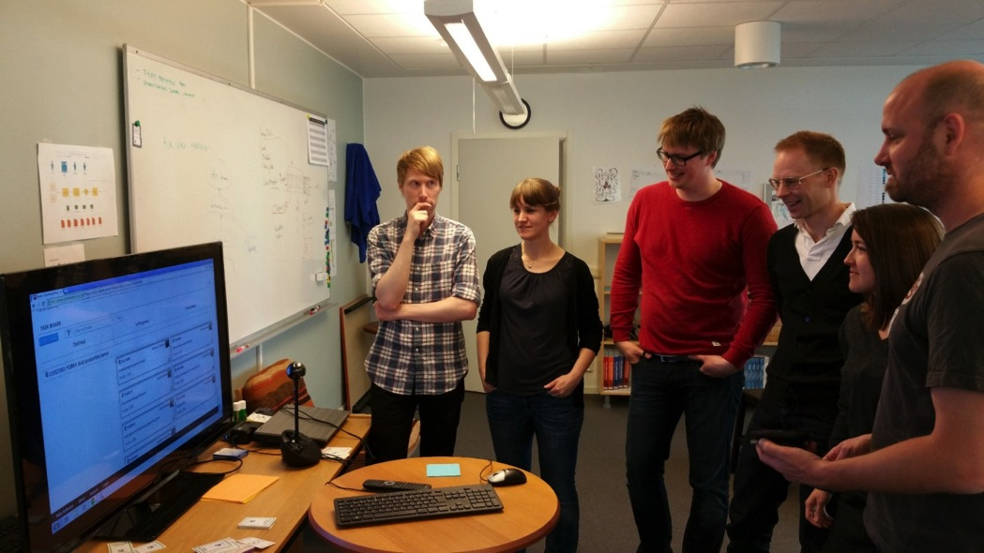
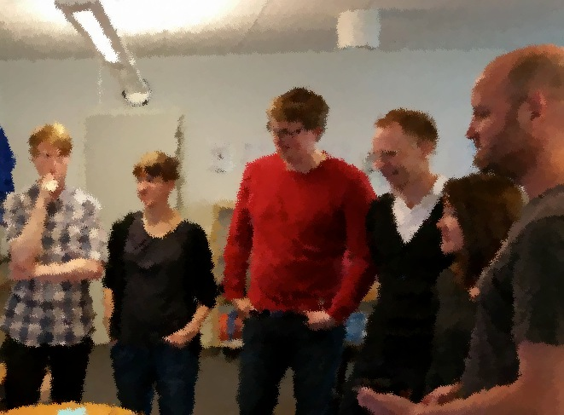
When do we have a functioning team?
Guided by the vision/big picture
Understands the domain
Self organized
Empowered
Drive continuous improvements
Collaborate and communicate cross teams
Build team of teams
Notes:
Scrum XP is prescribed on team level
The team have to know where they fit in the big picture
Transformation necessary → SAFe mindset (look outside the team as well)
It all starts on team level → consistent usage of all tools & procedures
SAFe addresses building team of teams. Facilitating collaboration cross team and cross sites is a key for program level management.

Slide 35
Conclusions
Notes:
So what have we learned so far? We have not yet made any release on the new software platform and do not yet have any evidence that we are faster or better, but we can see improvements.
What are the 3 best tips for starting up SAFe?
Get buy in from management – this is nothing that is isolated to development
Plan for a lot of training and exchange of practices to ensure an understanding of the principles behind (the mechanics are easy to learn). Bring in consultants/experts!
Use agile to introduce it (don’t wait until everything is planned and in control, just start)

Slide 36
What we have gained through the introduction of SAFe
Insufficient work on design and architecture
Silos between scrum teams
Dependency and integration issues
Unclear overall objectives & plan
Lack of visibility of the big picture
Scrum of scrum not being effective
Improved quality
Cross site and cross functional collaboration
PI Planning provides both vertical and horizontal alignment
Transparency through Rally, reports & SAFe ceremonies
Agile Portfolio estimation & planning drives realistic Portfolio plan
Notes:
Remember the bad we saw when scaling up Scrum. Insufficient system design and architecture, teams working in silos with dependency and integration issues, lack of big picture etc.
The main value that we have seen through the introduction of SAFe are:
Improved code quality already through Scrum
The program execution provides cross site and cross function collaboration.
PI planning provides both vertical and horizontal alignment. Teams know what other teams are doing, teams knows what business expect and business what teams can deliver.
Transparency through working in the same system and regular demonstrations.
And agile estimates and planning drives realistic long term planning.
However, all gaps are not filled yet…

Slide 37
Lessons Learned from our Agile Journey
We still need more effort on:
System architecture & design
Work definition, estimates & prognosis
Cross team & cross site collaboration
We did not staff our system teams sufficiently
Consistent use of Rally is important and not trivial
There is a constant need to maintain good engineering practices, adherence to done criteria etc., to obtain good quality
And we still have to much works-in-progress
Notes:
We still need more work on…
System architecture and design.
Work definition and estimates. It is not trivial to write good epics, features or user stories. We need to put more effort on it.
Cross team & site collaboration does not happen by itself.
We did not staff our system teams sufficiently, need to add more people there and work more on integration.
Consistent use of Rally is important (how we handle bugs, split user stories, define done criteria etc.) to get consistent data that we can trust.
There is a constant need to maintain good engineering practices, adherence to done criteria etc., to maintain good quality. It is so easy to fall back to old patterns.
And we need still to prioritize harder at program and portfolio level. Align PM to each other and to BM.
SAFe gives the framework for all this, but you still have to do the work, and do it good!
What would you say are our largest current challenges?
(next slide)

Slide 38
Our largest current Challenges
Refine value streams and rearrange trains to overcome large geographical distribution
Derive global priorities from business value
Empower the teams and get the teams in charge of engineering quality
How to handle release management of medical device in SAFe
Notes:
Refine value streams and rearrange trains to overcome the large geographical distribution. Actually takes a complete reorganization and substantial competence development to make it ideal (that is, when a geographical area can manage a value stream).
Derive global priorities from business value. We still do a lot of estimates and planning and “try to fit all in”.
Empower the teams and get the teams in charge of engineering quality. I think this is one of the main tasks of management. Teams that are not experienced Scrum teams tend to put quality in hands of PO/PM instead of taking the lead for good engineering practices.
How to handle release management of medical device in SAFe? How far in deliver on demand can we go and still fulfill regulatory requirements?

